Slide 1
President’s Report
April 2018

Slide 2
Overview
Committee – Outgoing
Sydney Conference
Policy
Membership Survey
Publications

Slide 3
Committee
ASEG FedEx 2017
President: Andrea Rutley
President Elect: Marina Costelloe
Treasurer: Danny Burns
Secretary: Megan Nightingale
Conference: Kim Francombe
WebMaster: David Annetts
State Representative: Marina Pervukhina (new!)
Education: Marina Pervukhina (new!)
Communications: Kate Robertson (new!)
Membership: Katherine McKenna
Publications: ??
Other: Andrew Squelch (new!)
Other: Leslie Atkinson (new!)
Always looking for more hands to help us!

Slide 4
Policy
Policy and Procedures
  Strategic Plan (2018 work)
  Succession Planning
  Fixed Term Guidelines – how long is “good service” vs “too long”
  Ethics and Code of Conduct Policy

Slide 5
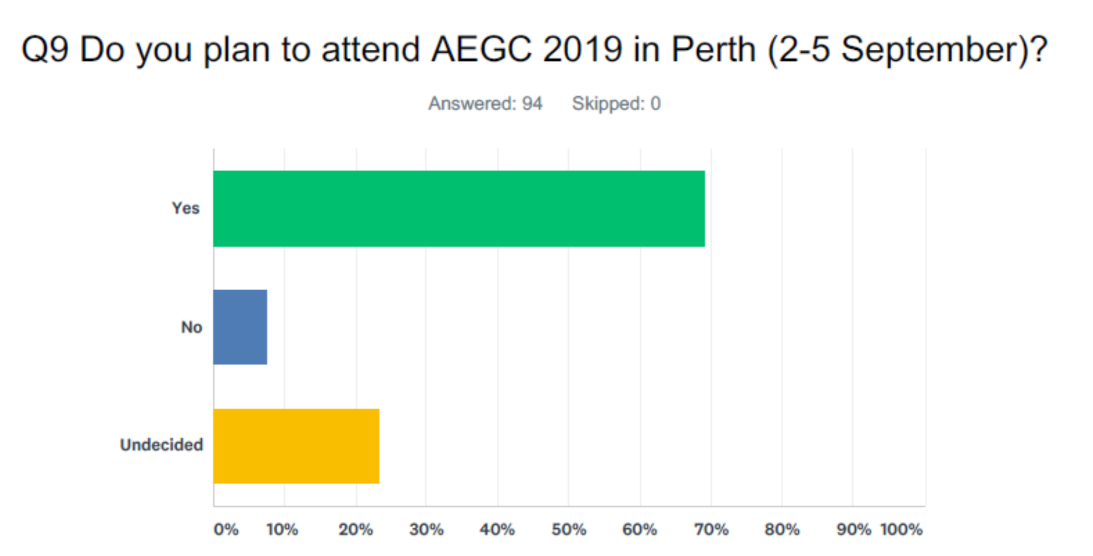
Conference
First joint conference with AIG, PESA and ASEG – 958 attendees
Some things worked well; other areas – room for improvement
Perth following similar format, with lessons learnt from Sydney being considered by Conference Organising Committee
Four most important reasons for attending the conference (small sample):
  Quality of oral presentations
  Quality of keynote speakers
  Industry exhibition
  Networking
Get these right and we have a successful conference
Preference to attend Perth:
  Results before Sydney Conference:
    30% = Yes
    30% = No
    40% = Undecided
  After Sydney Conference
    70% = Yes
    7% = No
    23% = Undecided
Different demographic – but strong indicator

Slide 6
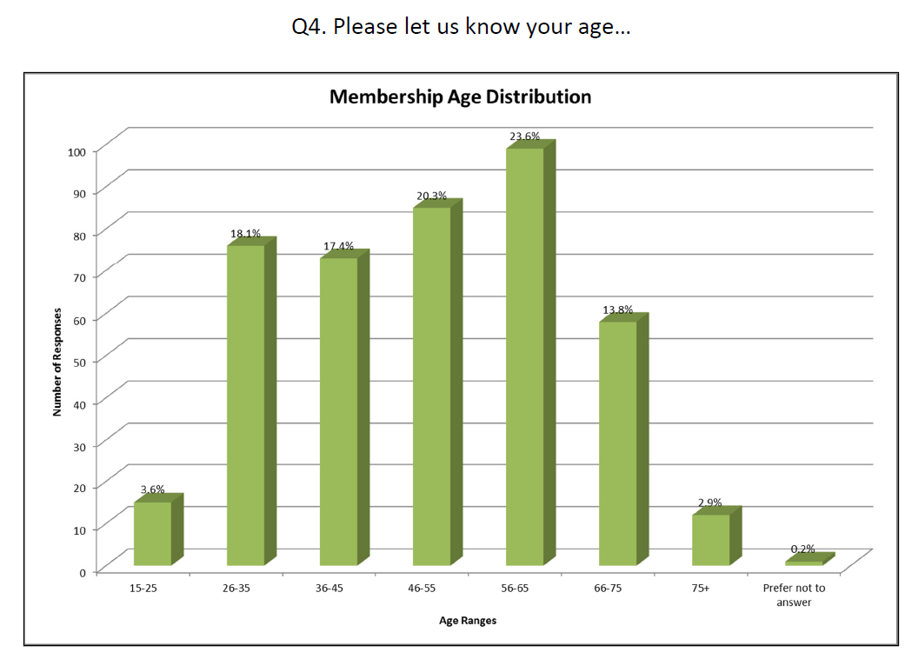
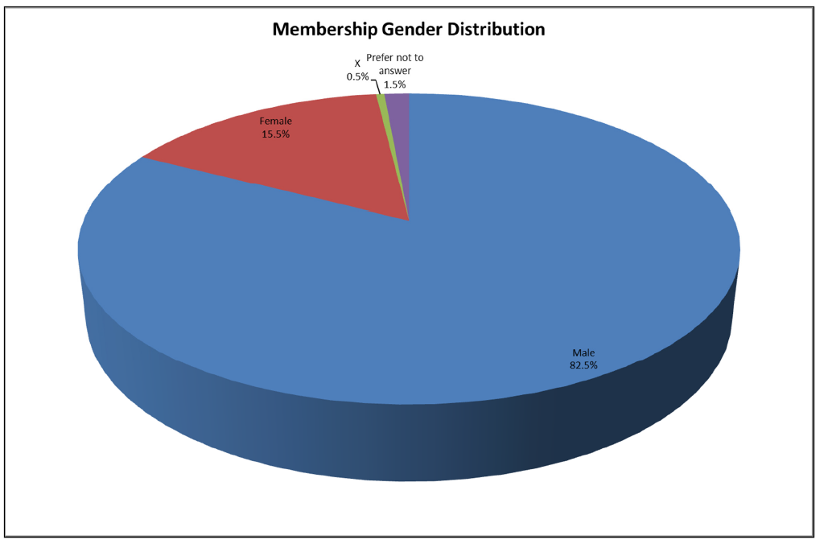
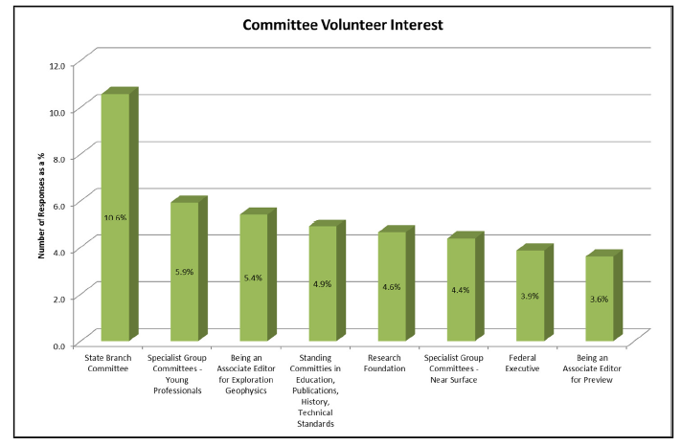
Survey
44%
Great response (>400 members)
Key Points:
  Male (82%); Female (16%) (2% NA) Well below industry standard
  International members – majority USA + Canada, then RSA
  Age: 44% in 46-65years
  Employment: Permanent (50%) Self-employed (17%)
  Email preferred communication, including newsletter
  High value – Conferences & Publications
  Volunteer rate low with only 11% willing to help in State branch Committees and 4% on FedEx
Many challenges for 2018 which are being worked on in various sub-committees
How does this relate to our membership stats – some correlation, but more work to do to understand potential impact and how to address solutions
82%
10%
4%

Slide 7


Publications
Currently tenders received and under evaluation for successful publisher for ASEG
Survey targeted publication questions:
  Exploration Geophysics rated as highest value publication
  Preview second
  Other publications such as special editions, conference and membership handbooks rated lower
  Electronic versions of publications preferred in Exploration Geophysics with Preview as the “coffee table” book
  80% of respondents were satisfied with Preview, believing it is going from strength to strength
Publications Committee is in for a big 2018
Need a Chair for the committee and more willing assistants

Slide 8

Next Steps
Look towards 2018 FedEx – new members
International Committee remains active and will be a focus in 2018, particularly as we focus to grow our membership base and provide valuable exposure of the ASEG worldwide
Growth in committee members
Strategic Plan utilising results from the survey to ensure growth platform:
  Young Professionals
  Mentor Programmes
  Benefits to members
  Even stronger publications and increased Impact Factors
And … 50th Anniversary of ASEG fast approaching …. Planning underway for a BIG year
Thank you to all the current FedEx and welcome to the 2018 Incoming FedEx

